Slide 1
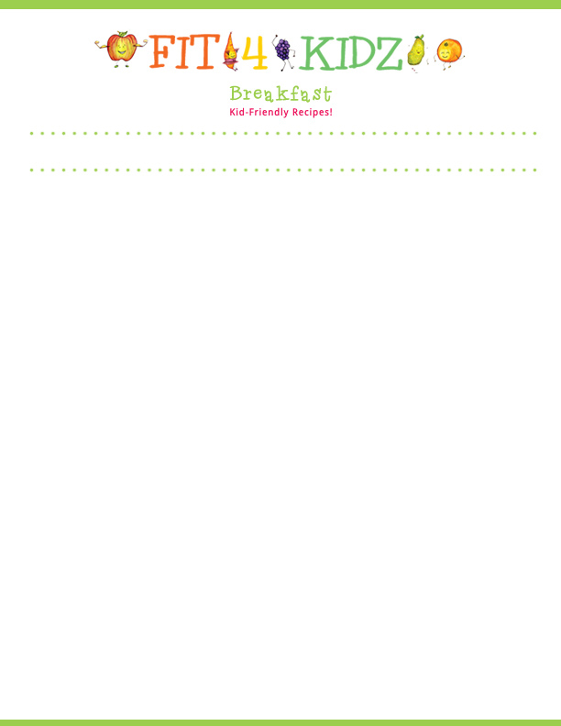
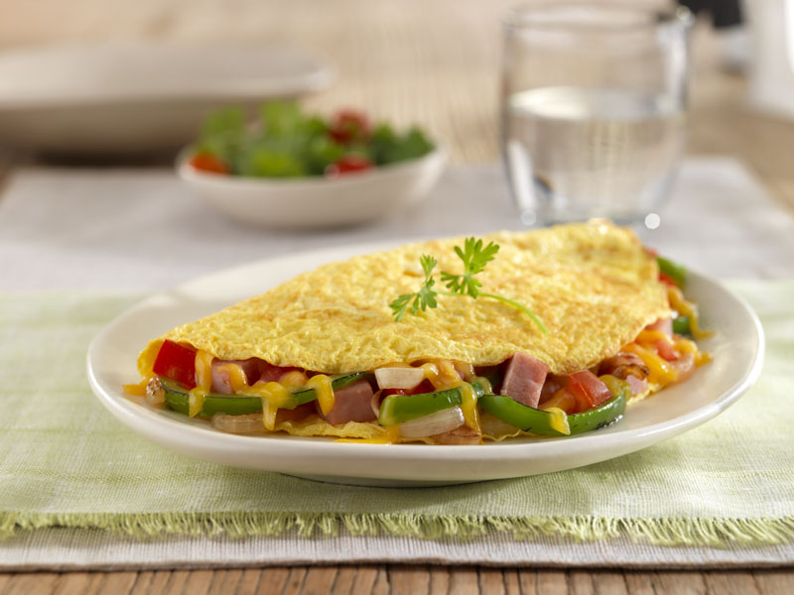
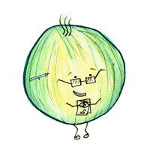
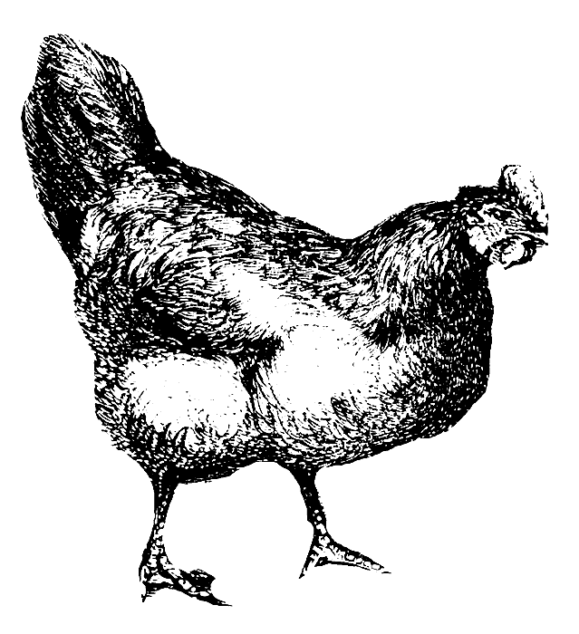

Serving Size for 1500 Calorie/Day Plan
Calories from this Meal: 298
Preparation Key: *Kids **Parents
Eggie Omelet
INGREDIENTS
Light spread- 1 tsp Onion- ¼
Egg White- 2 Low-fat shredded cheddar cheese- ¼ cup
Egg- 1 Mushrooms, chopped- ¼ cup
Green Bell Pepper- ¼ Whole Wheat bread- 1 slice
Tomato- ¼ Jelly or jam- 1 tsp
PREPARATION
**Heat a non-stick skillet.
* In a mixing bowl, thoroughly beat egg white and eggs.
**Chop veggies (if desired, sauté veggies for a few minutes in a separate pan before placing in the omelet).
*Add butter to the heated skillet. Once butter is melted, pour egg mixture into skillet.
*When egg mixture is set and the bottom has browned slightly, add veggies and top with cheese. Cook omelet until egg is desired texture, fold and serve with a slice of bread and jelly.
Eating a veggie loaded omelet for breakfast is a protein and vegetable packed breakfast, that will provide you with a great source of protein from the egg whites as well as other nutrients from any of the vegetables you include. Both the protein and any vegetables you add count towards your daily recommended servings for the protein and vegetable food group.
Did you know that the older a hen gets, the bigger their eggs get?
Copyright ©2015 Fit4Kidz.us |All Rights Reserved | www.fit4kidz.us

