Slide 1
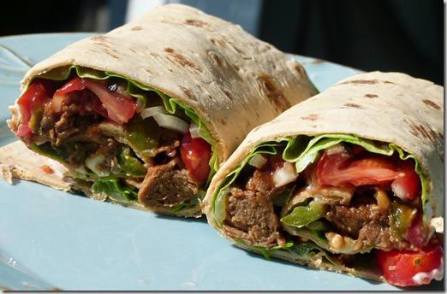

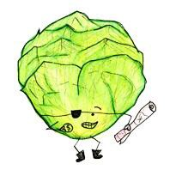

Serving Size for 1500 calories/day Plan
Total Calories in this Meal: 518
Preparation Key: *Kids **Parents
Cheese Steak Wraps
INGREDIENTS
Whole wheat flour tortilla - 1
Beef top round - 3 oz Brown gravy mix - ½ oz Water - 1 oz
Green onion - 1 Green bell pepper - ½
Low-fat cheese - 1 slice Whole wheat roll - 1 Skim milk - 1 ½ cup
PREPARATION
Place sliced beef in the bottom of an electric slow cooker. Mix together gravy mix and water, and pour over the steak. Add green onions and bell peppers.
Cook on low setting for 6 to 8 hours, or until beef is tender.
Spoon meat, onions, and peppers into a whole wheat flour tortilla, and top with low-fat cheese before rolling it
up.
Cheese steaks originated in Philadelphia, Pennsylvania! It’s hard to find a cheesesteak as good as the originals from Philly.
They were created when a hot dog vendor, Pat Olivieri decided to put some beef on his grill- then cheesesteaks were made!
Copyright ©2015 Fit4Kidz.us |All Rights Reserved | www.fit4kidz.us

