Slide 1
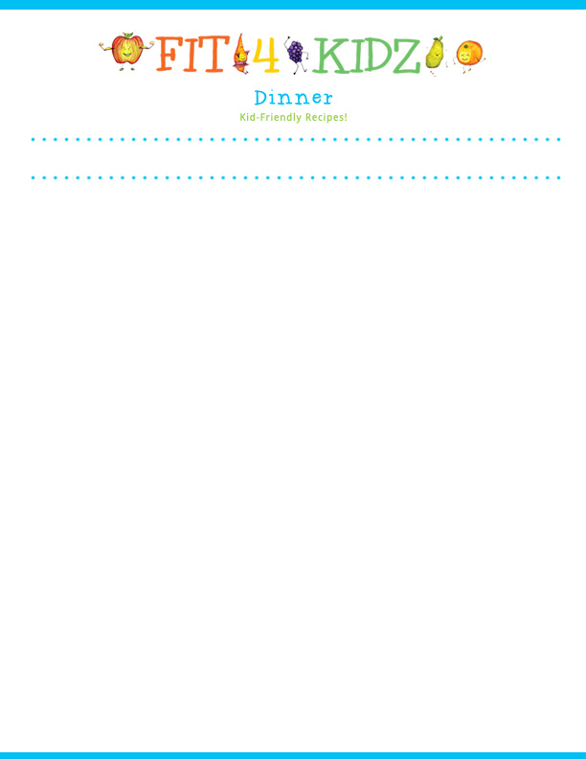
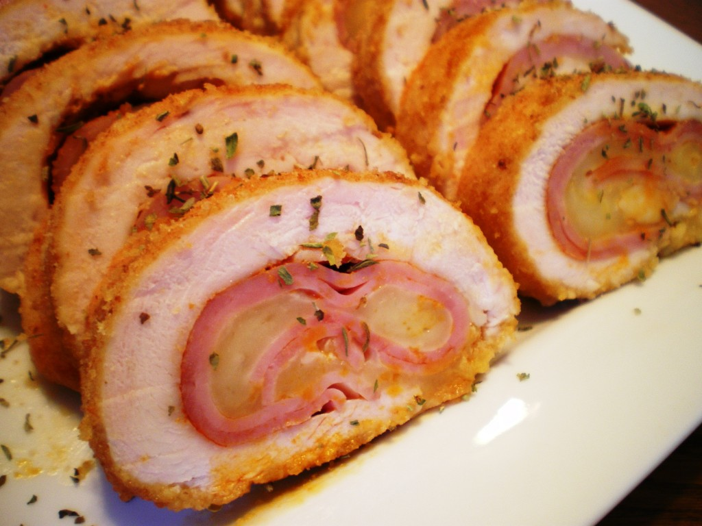



Serving size for 1500 calorie/day plan
Calories in this meal: 513
Preparation Key: *kids-can-help **parents
Cheesy Hammy Chicken
INGREDIENTS
¾ oc Skinned chicken breast 1 cup Broccoli Seasonings:
½ oz Extra-lean deli ham 1/3 cup Corn Coarse black pepper
1 slice Lite Swiss Cheese 1 tsp Light spread Garlic clove
½ Egg Dinner salad with dressing Salt
1 slice White onion ½ Whole wheat roll
2 Tbl Bread crumbs
Vegetable cooking spray
PREPARATION
**Preheat oven to 350 degrees F.
**Thoroughly pound chicken so it can be easily folded in half.
**Spray non-stick skillet with vegetable spray.
**Lightly brown both sides of chicken breast over medium heat and then remove from skillet.
*Place ham and cheese inside the chicken and fold in half. Secure with toothpicks.
*In a bowl, slightly beat egg and 1 teaspoon of water. Mix in ¼ tsp minced garlic clove and onion.
*In a second bowl, mix bread crumbs with a dash of salt and black pepper.
*Dip chicken in egg mixture and roll in bread crumbs. Repeat dip and roll until chicken is thoroughly coated.
**Spray baking pan with vegetable cooking spray and bake chicken for 15 to 20 minutes.
Serve with Dinner salad and Whole wheat roll.
Eating baked chicken is healthier than fried chicken because fried chicken is cooked in oils which contain more fat than baked chicken. Limiting fats in your diet helps you from getting extra unwanted calories, which in turn keeps you thinner!
Did you know there are more chickens in the world than people?
Copyright ©2015Fit4Kidz.us |All Rights Reserved | www.fit4kidz.us

