Slide 1
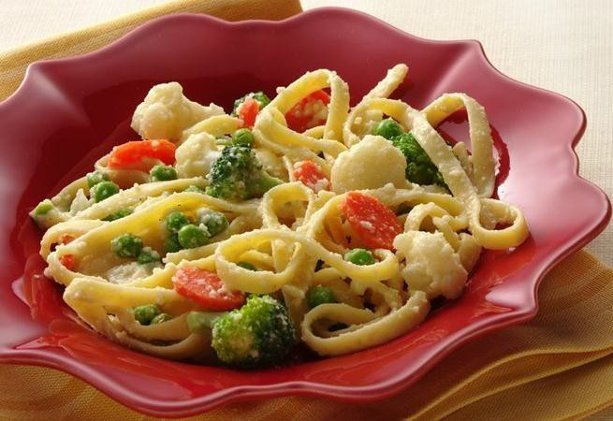

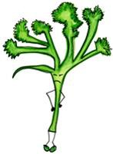

Serving Size for 1500 calories/day plan
Total Calories in this Meal: 516
Preparation Key: *Kids **Parents
Cheesy Veggies and Pasta
INGREDIENTS
Fettuccine - 2 ¼ oz Broccoli - 2/3 cup Mushrooms - 2/3 cup Carrot - ½
Zucchini - ¼ cup Yellow squash - ¼ cup Milk, 2% - ¾ cup Cornstarch - 1 tsp
Vegetable broth, low-sodium - ¼ cup Grated Parmesan cheese - 1 Tbl Part-skim ricotta cheese - 1 ½ Tbl Whole wheat roll - 2/3
Garlic clove Salt Thyme
White pepper
PREPARATION
**Cook fettuccine al dente. Drain and cool.
**Steam broccoli (diced into florets), carrots (peeled and diced), zucchini (cut in 1/8“ sliced), squash (cut in 1/8" slics) and mushrooms (sliced) together for 2 minutes.
*Dilute cornstarch in 2 % milk, mixing thoroughly.
**Bring vegetable broth to a simmer with 1 tsp. garlic (finely minced), 1/4 tsp. thyme, or (1/8 tsp. dry), 1 pinch of salt and 1/4 tsp. white pepper.
**Add cooked fetuccini and heat thoroughly.
**Add milk, cornstarch combination to pasta and return to simmer with grated Parmesan cheese and ricotta cheese (part-skim or cottage cheese).
*Dress on plate and top with hot steamed vegetables. Spoon on remaining sauce.
*Garnish with a sprig of fresh thyme.
Many people think that protein comes from just meat, but this meal is vegetarian and still contains 25 grams of protein!
Beans, vegetables, grains and nuts can all be good sources of protein.
Copyright ©2015 Fit4Kidz.us |All Rights Reserved | www.fit4kidz.us

