Slide 1
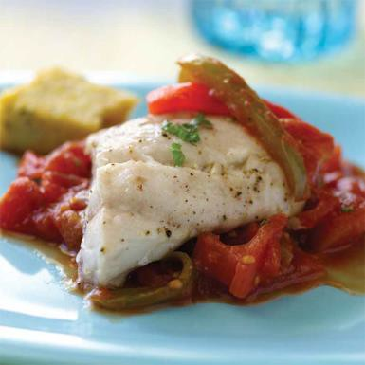

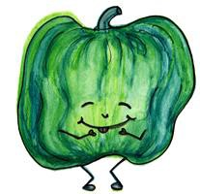

Serving Size for 1500 calories/day plan Total Calories in this Meal: 522
Preparation Key: *Kids **Parents
Italian Saucy Snapper
INGREDIENTS
Snapper - 4 ¼ oz
Italian bread crumbs - 1 ½ Tbl Low-fat Italian dressing - 3 Tbl Purple onion - ¼ cup
Green bell pepper - ¼ Tomato sauce - ½ cup Vegetable cooking spray - 1
Corn - ¼ cup
PREPARATION
Light spread - 2 tsp Dinner salad, w/dressing - 1 Whole wheat crackers – 5 Basil
Garlic Pepper Salt
*In a bowl, combine Italian bread crumbs, pinch of salt and pepper, and 1 teaspoon basil.
*In a second bowl, pour Italian dressing. Dip fish in dressing and then roll in bread crumb mixture. Repeat dip and roll process until fish is thoroughly coated.
**Treat non-stick skillet with vegetable cooking spray. Cook fish over medium-high for 2-3 minutes. Turn over
and cook second side for 2 minutes or until fish flakes easily with a fork.
**Remove fish from skillet.
**Re-treat skillet with vegetable cooking spray, reduce heat to medium, and saute‘ onion and green pepper until onion is translucent.
*Stir in tomato sauce and 1/4 teaspoon garlic pepper.
**Continue to heat mixture, stirring constantly, until thoroughly heated.
*Serve fish topped with sauce.
Red snapper can grow to about 40 inches, weigh up to 50 pounds and live more than 50 years.
Snapper is the most popular white fish, and like most fish, provides very important fatty acids for your body.
Copyright ©2015 Fit4Kidz.us |All Rights Reserved | www.fit4kidz.us

