Slide 1
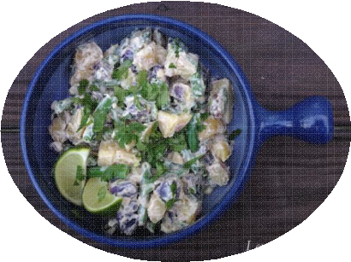

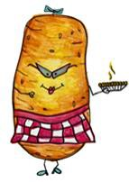
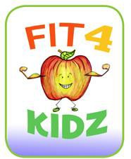
Serving Size for 1500 calories/day plan Total Calories in this Meal: 510
Preparation Key: *Kids **Parents
Mexican Potatoes
INGREDIENTS
Potatoes - 9 oz
Green beans - 3 oz Light spread - 1 1/8 tsp Onion - 5 ½ Tbl
Hot chili pepper - 1 1/8 tsp Stewed tomatoes - 1 cup Cottage cheese, 2% - ¼ cup
Monterey Jack low-fat cheese - 2 Tbl
Cumin Garlic clove Oregano Salt
PREPARATION
*Wash and **quarter potatoes lengthwise and steam.
**Cut green beans in 1" pieces and steam separately until barely done.
**Heat light spread in a skillet. Add chopped green chili (optional), chopped onion, ½ clove garlic minced, 1/2 tsp. cumin, ½ tsp. oregano and sauté.
*Stir in tomatoes and 1/8 tsp. salt and simmer for 12 minutes.
*Stir in 1 cup cottage cheese (2%) and Monterey Jack cheese (grated); **heat until melted.
*Combine with potatoes and green beans and serve immediately.
Mexican food has always been considered to be very spicy. In this recipe, we use hot chili pepper! If you do not like spicy food, you may want to use less.
Since there is no meat in this recipe, our main source of protein is in the cheese. Altogether, this is a very balanced meal.
Copyright ©2015 Fit4Kidz.us |All Rights Reserved | www.fit4kidz.us

