Slide 1
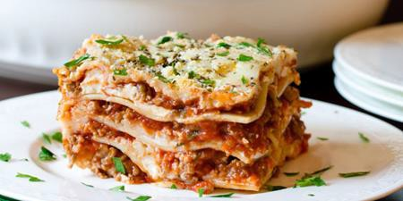



Serving Size for 1500 calories/day plan Total Calories in this Meal: 514
Preparation Key: *Kids **Parents
Pop-Eye Lasagna
INGREDIENTS
1 ¼ oz Lasagna
5 oz Chopped Spinach
½ cup Part-Skim shredded
mozzarella cheese
¾ Tbl Grated Parmesan Cheese
1/3 cup 2% cottage cheese
1 spring onion
¼ cup Spaghetti Sauce Vegetable Cooking Spray Basil
Oregano
PREPARATION
**Cook lasagna according to package instructions.
**Chop fresh spinach or thaw frozen chopped spinach (microwaving can speed thawing) *and squeeze out excess
moisture.
*Preheat oven to 350 degrees.
*Mix spinach, mozzarella cheese, Parmesan cheese, cottage cheese, onion, 1/8 tsp oregano, and 1/4 tsp basil in a bowl.
*Lay cooked lasagna out flat on a covered baking dish which has been treated with vegetable cooking spray.
*Spoon cheese mixture on top of lasagna.
*Spoon a thin layer of spaghetti sauce on top of cheese mixture.
**Gently roll lasagna up, cover, and bake for 10 to 12 minutes. Heat remaining spaghetti sauce, on medium heat.
*Top lasagna when it is removed from oven.
The word, “lasagna”, comes from “lasagnum”, the Greek word for dish or bowl!
Copyright ©2015 Fit4Kidz.us |All Rights Reserved | www.fit4kidz.us

