Slide 1
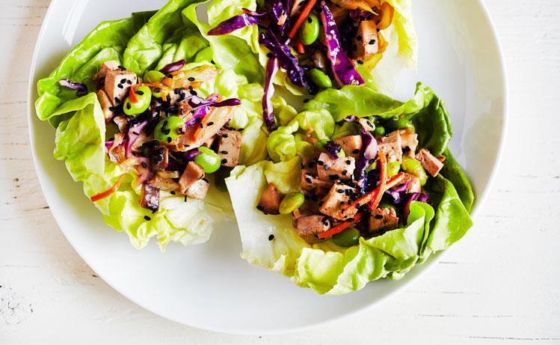



Serving Size for 1500 calories/day plan Total Calories in this Meal: 519
Preparation Key: *Kids **Parents
Sesame Tofu
INGREDIENTS
Red wine vinegar - 1 Tbl Cooking oil, peanut - ¾ tsp Brown rice, uncooked - 4 ½ Tbl Wonton wrappers - 3
Romaine lettuce - 1 cup Raw tofu - 3 1/2 oz
Bean sprouts - ½ cup
PREPARATION
Cabbage - 1 ¼ cups Carrot - 1
Yellow bell pepper - 1 Jalapeno pepper - 1 ½ tsp Snow peas - ½ cup Sesame Seeds
*Whisk together vinegar and oil, along with 1 dash sesame oil, 1 pinch white pepper, 1/8 teaspoon fresh ginger (minced**) and 1 pinch dry mustard. Save Vinaigrette for later.
**Cook brown rice according to package directions.
**Bake wontons in a 375 degree F heated oven for 2 minutes. Save for garnish.
*Trim and clean romaine lettuce. Arrange on a salad plate to form a cup in the center of the plate.
*Preheat a non-stick pan and spray with vegetable spray. **Saute' tofu thoroughly.
**Add remaining vegetables. Stir-fry until tender-crisp, approximately 3 minutes.
*Place cooked rice on top of romaine lettuce.
*Dress rice and lettuce with stir-fry.
*Spoon vinaigrette over top and sprinkle with 1/8 teaspoon sesame seeds.
Garnish with wontons on the side.
What is tofu?
Tofu is a common ingredient in Asian cooking. It is made of soybeans. Many vegetarians eat tofu because it has a significant amount of protein, which is normally found in meat.
Copyright ©2015 Fit4Kidz.us |All Rights Reserved | www.fit4kidz.us

