Slide 1
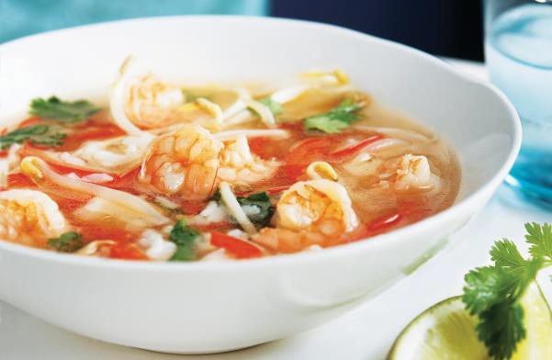



Serving Size for 1500 calories/day Plan Total Calories in this Meal: 512
Preparation Key: *Kids **Parents
Shrimp and Coconut Soup
INGREDIENTS
Shrimp - 3 ounces Coconut milk - ¼ cup Olive oil - ½ tablespoon Red onion - 2 slices
1/8 Habanero Chile Pepper Mushrooms - ¼ cup
Tomatoes, canned and peeled
- 4 oz
Annatto Seeds Fresh Cilantro Salt
PREPARATION
**Place olive oil and annatto seeds in a large sauce pan over medium heat.
*Cook for three minutes- watch the oil until it turns red-orange.
**Strain seeds out of oil, return oil to pan.
*Add onions and chile pepper and sauté for 2 to 3 minutes.
*Add peeled tomatoes, coconut milk, salt and shrimp.
**Cover and cook for 3 to 5 minutes, until shrimp are thoroughly cooked.
*Stir in fresh minced cilantro just before serving.
Did you know that there are over 128 types of shrimp? Most average about 6 inches long, but the biggest shrimp ever found was over 16 inches long!
Shrimp are low in calories, but high in protein and contain
healthy fats!
Copyright ©2015 Fit4Kidz.us |All Rights Reserved | www.fit4kidz.us

