Slide 1
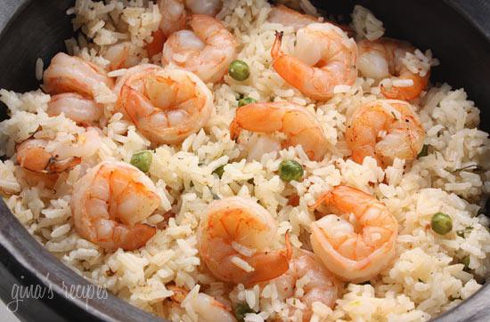



Serving Size for 1500 calories/day plan
Total Calories in this Meal: 535
Preparation Key: *Kids **Parents
Shrimp and Peas Please
INGREDIENTS
Shrimp - 5 oz
Brown rice - 4 Tbl
Chicken bouillon powder - ½ tsp Low-sodium soy sauce - 2 tsp Cornstarch - 1 tsp
Light spread - ½ tbl
Green peas - 1/3 cup
Pineapple rings - 1
Light cream cheese - 1¼ Tbl Skim milk - 3/4 cup
Garlic Clove Parsley Flake
PREPARATION
**Prepare rice according to package instructions.
**Dissolve chicken bouillon powder in 1/2 cup hot water. Add soy sauce and cornstarch and mix well.
**Melt light spread in a non-stick skillet over medium heat and lightly saute' 1 small minced garlic clove until softened.
*Add shrimp to skillet and cook, stirring frequently, for about 5 minutes or until shrimp turns pink.
*Add peas and then gradually stir in bouillon mixture.
**Continue heating and stirring until sauce is slightly thickened and smooth.
*Serve over a bed of rice and garnish with 1/4 teaspoon of parsley flakes.
Garlic is low in calories and very rich in Vitamin C, Vitamin B6 and Manganese. It also contains trace amounts of various other nutrients.
Also, garlic helps lower cholesterol, decreasing your risk of heart disease!
Copyright ©2015 Fit4Kidz.us |All Rights Reserved | www.fit4kidz.us

