Slide 1
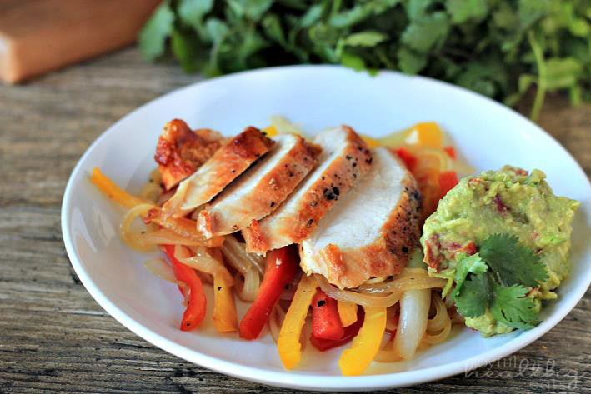



Serving Size for 1500 calories/day plan Total Calories in this Meal: 525
Preparation Key: *Kids **Parents
Southwest Chicken and Peppers
INGREDIENTS
Chicken breast - 3 1/4 oz 1 Red bell pepper
1 Onion
1 cup Mushrooms
1 cup Chicken broth, low sodium
½ cup Broccoli 1 cup Skim milk Pepper
PREPARATION
*Place the chicken breast in the bottom of an electric slow cooker.
*Add remaining ingredients.
*Cover and cook on low setting for five hours.
Did you know that Southwest food has influences from Spain, Mexico and Native American culture? States that have the most food from these places are the in Southwest region of the United States- like New Mexico, Arizona, California and Colorado.
Copyright ©2015 Fit4Kidz.us |All Rights Reserved | www.fit4kidz.us

