Slide 1
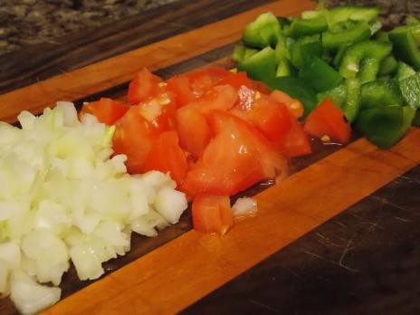
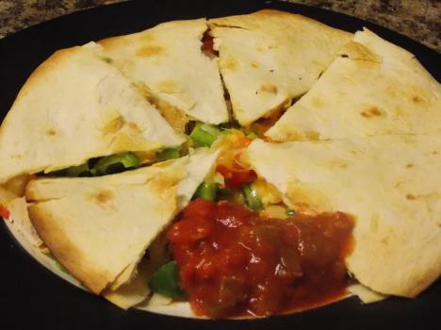


Serving Size for 1500 calorie/day plan Calories in this meal: 382
Preparation Key:
*Kids can help **parents needed
Quesadilla
INGREDIENTS
2 Whole wheat flour tortilla 3 oz Chicken breast, cubed 1/3 cup Tomato
2 tbl Low-fat shredded cheddar cheese
½ chopped Onion,
½ Green bell pepper
PREPARATION
**Cook chicken breast and cube.
¼ cup Salsa
1 Tbl Sour cream 6 Tortilla chips
**Dice tomato, onion and green bell pepper.
*Place tortilla on baking sheet.
*Top tortilla with tomato, chicken, onions, green pepper, and cheese.
*Top with the remaining tortilla.
**Bake at 450 degrees for approximately 5 minutes or until light brown.
*Top with salsa and/or sour cream.
PREPARATION
The word “quesadilla” is a combination of two Spanish words. “Bocadilla” is Spanish for sandwich, and “queso” means cheese. So, “quesadilla” is just like saying, “cheese sandwich” in Spanish!
Copyright ©2015 Fit4Kidz.us |All Rights Reserved | www.fit4kidz.us

