Slide 1
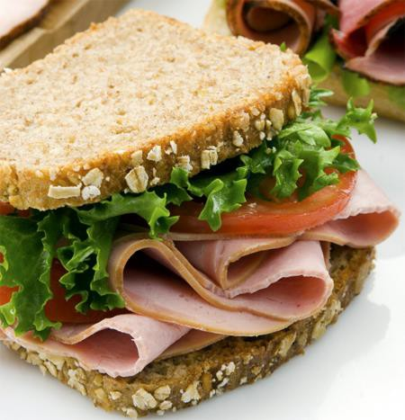


Serving Size for 1500 calorie/day plan
Calories in this meal: 375
Preparation Key:
*Kids can help **parents needed
Superhero Sandwich
INGREDIENTS
2 slices Whole Wheat Bread 2 ½ oz Lean Deli Meat
1 ½ Tbl Reduced Fat Mayonnaise
1 Lettuce Leaf
¼ Tomato
5 Celery sticks
1 Medium Apple
3 Dill Pickle Spears
PREPARATION
*Toast your bread.
*Spread mayonnaise on both slices.
http://www.harvestranchmarkets.com/wp-
content/gallery/2-deli/hrm_hamsand_istock.jpg
*Layer tomato slices, lettuce leaf and deli meat on the sandwich.
*Enjoy with celery sticks, an apple and 3 pickle spears!
Did you know that Americans eat more than 300 million sandwiches every day? They are one of the most popular foods of the American diet. They can be filled with many different ingredients. The two slices of bread make sandwiches easy to hold and convenient for on-the-go meals!
Copyright ©2015 Fit4Kidz.us |All Rights Reserved | www.fit4kidz.us

