Slide 1
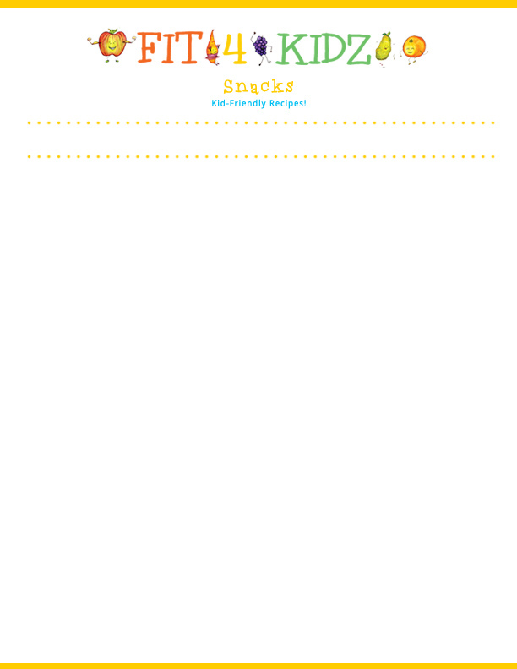
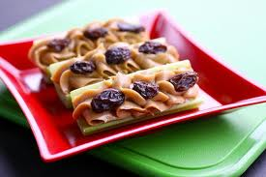

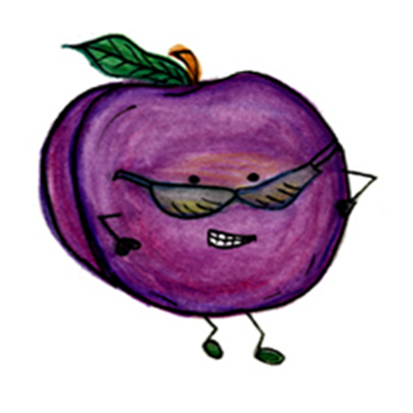

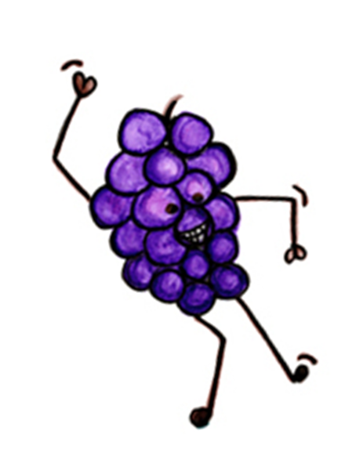

Serving Size for 1500 Calorie/Day Plan
Calories in this Meal: 89
Preparation Key: *Kids **Parents
Ants On a Log
INGREDIENTS
Celery –4 sticks
Natural-creamy peanut butter – ½ tbsp
Seedless raisins- 2 ½ tsp
PREPARATION
**Cut celery to desired length
*Spread on peanut butter
*Top with raisins
Enjoy!
Did you know there are 200 billion pounds of celery grown annually in the U.S!
Eating celery with a little peanut butter and raisins is an excellent way to snack AND get a serving of vegetables, fiber as well as protein from the peanut butter Choose natural peanut butter for good nutrition!
Copyright ©2015 Fit4Kidz.us |All Rights Reserved | www.fit4kidz.us

