Slide 1


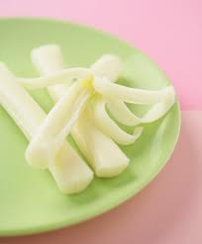


Serving Size for 1500 Calorie/Day Plan
Calories in this Meal: 120
Preparation Key: *Kids **Parents
Applesauce with Crackers
INGREDIENTS
Unsweetened Applesauce- 1/3 cup
Wheat snack crackers, low-salt- 5 crackers
String Cheese part-skim mozzarella- ½ stick
PREPARATION
*Pour applesauce into a bowl and serve with crackers and cheese
Enjoy!
Did you know…
…Make sure to use wheat crackers when preparing this snack. Wheat crackers will be higher in fiber and have more Vitamin E than plain crackers. Another health benefit to this snack is that applesauce is high in vitamin C, fiber and complex health sugars.
Copyright ©2015 Fit4Kidz.us |All Rights Reserved | www.fit4kidz.us

