Slide 1
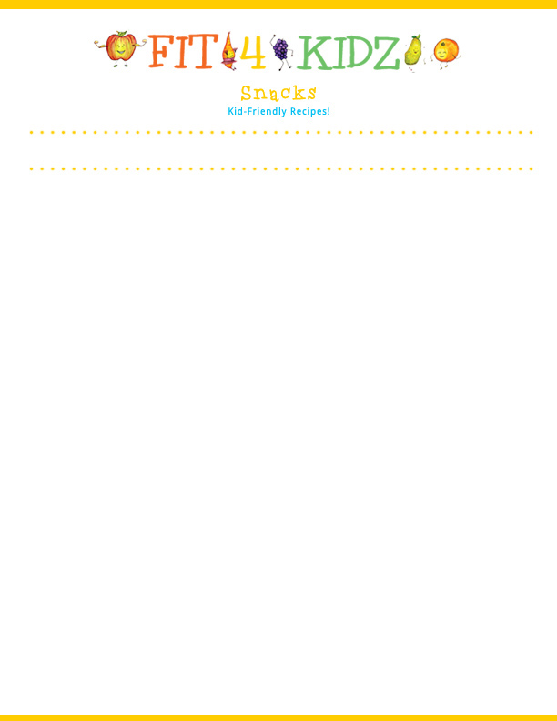
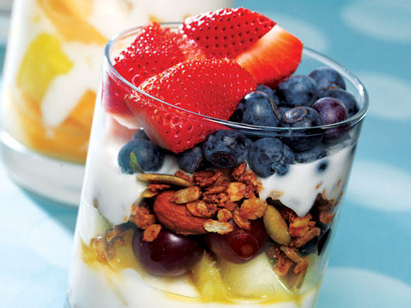




Serving Size for 1500 Calorie/Day Plan
Calories in this Meal: 88
Preparation Key: *Kids **Parents
Berry Sweet
INGREDIENTS
Strawberries (sliced)- ½ cup
Unsweetened blueberries- 1/3 cup
Raspberries- 1/3 cup
Whipped Cream- 2 Tbl
Granola – ½ tsp
PREPARATION
**Slice strawberries
*In a bowl, mix blueberries with sliced strawberries
*Top with whipped cream
*Add raspberries and granola.
All berries are a great source of vitamin C, fiber, and makes your plate colorful and are delicious!
Did you know raspberries can be red, purple, gold, or black and the sweetest of them are the golden ones?
Copyright ©2015 Fit4Kidz.us |All Rights Reserved | www.fit4kidz.us

