Slide 1

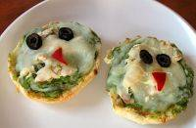

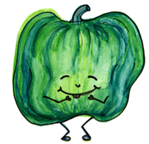

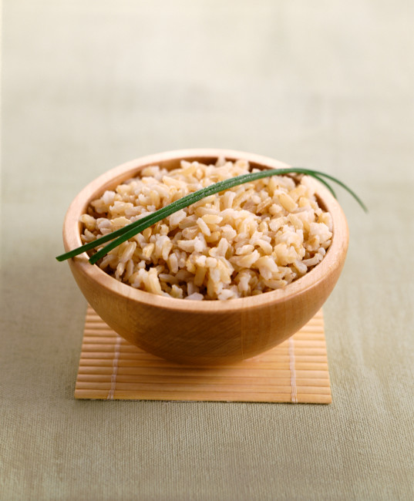

Serving size for 1500 calorie/day plan
Calories in this meal: 125
Preparation Key: *kids-can-help **parents
Cheesy Harry
INGREDIENTS
½ Multi-grain English muffin
½ slice Low-fat cheese
3 Black olives
¼ red bell pepper, sliced
1/3 cup Carrot, shredded
PREPARATION
*Top English muffin with cheese.
*Make a face using the carrots, black olives, and red pepper.
**Place muffins in oven or microwave oven until cheese melts. Allow to cool before eating.
Combining veggies and grains are a great healthy snack and fun to make! Getting your grains in on a daily basis might be a challenge, but there are plenty of options to choose from! Aim for 5 ounces of whole grains a day!
Did you know English muffins were first started in America by an English baker and are imported from America to English supermarkets?
Copyright ©2015 Fit4Kidz.us |All Rights Reserved | www.fit4kidz.us

