Slide 1
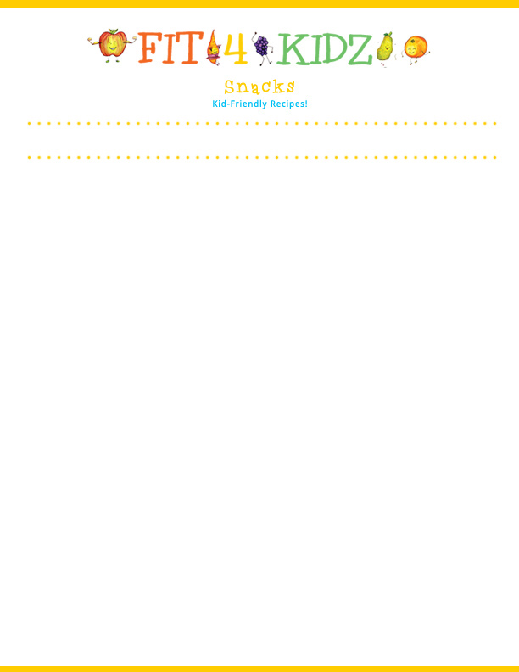
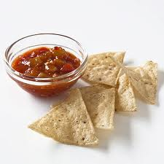
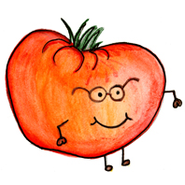
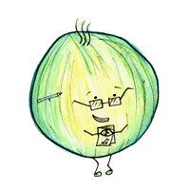


Serving Size for 1500 Calorie/Day Plan
Calories in this Meal: 88
Preparation Key: *Kids **Parents
Chips With Salsa
INGREDIENTS
Tortilla Chips, baked- 8 chips
Salsa – ½ cup
PREPARATION
* Pour salsa into a bowl and serve with chips
Enjoy!
Did you know that…
…When snacks are baked, they have less unhealthy fats in them than if they were fried. Frying is a method of cooking you want to avoid because it usually includes an unhealthy source of fat which is not good for your body.
…Salsa is packed with a ton of vegetables that all have beneficial vitamins and minerals in them to help you grow up healthily.
Copyright ©2015 Fit4Kidz.us |All Rights Reserved | www.fit4kidz.us

