Slide 1

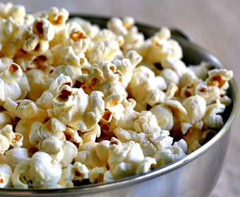




Serving size for 1500 calorie/day diet
Calories in this meal: 118
Preparation Key: *kids can help **parents
Mini-Popcorn Cakes w/ Fruit
INGREDIENTS
White Cheddar cheese mini-popcorn cakes- 11
Fruit or Juice- ½ serving
PREPARATION
*Enjoy a bag of mini-popcorn cakes with fruit or juice!
Popcorn makes an excellent snack choice because it is a natural whole grain. It contains fiber, anti-oxidants, is low calorie (when plain) and is super tasty! Adding fruit to this snack gives you more fiber and other vitamins and minerals necessary for your body!
Did you know that popcorn kernels can pop up to three feet in the air?
Copyright ©2015 Fit4Kidz.us |All Rights Reserved | www.fit4kidz.us

