Slide 1

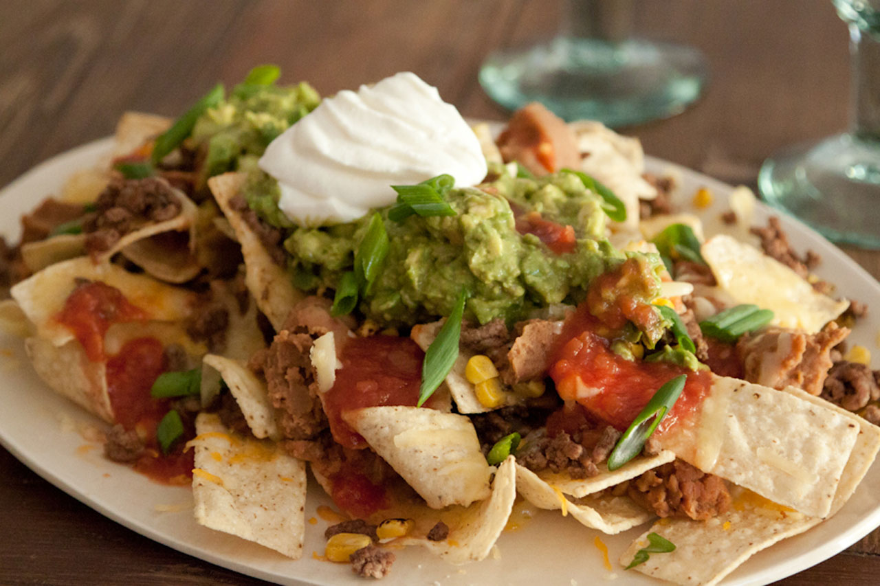
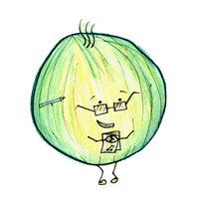
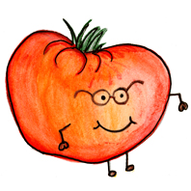


Serving size for 1500 calorie/day diet
Calories in this snack: 92
Preparation Key: *kids can help **parents
Nachos
INGREDIENTS
Tortilla chips, baked- 7
Salsa- 2 Tbl
Low-fat sharp shredded cheddar cheese- ½ oz
PREPARATION
*Place tortilla chips on microwave safe plate.
*Cover tortilla chips with salsa and shredded cheese.
**Heat in microwave for 15 seconds or until cheese melts.
Choosing low-fat cheese and baked tortilla chips instead of fried are much better options because they are reduced fat. This could easily be turned into a meal by adding cooked, lean ground beef; guacamole; black beans; sour cream; and sautéed vegetables.
Did you know that nachos were invented by a man named “Nacho” in 1943 Mexico when the wives of US soldiers were served a snack after store hours that was assembled with what little he had left in the kitchen: tortillas, and cheese?
Copyright ©2015 Fit4Kidz.us |All Rights Reserved | www.fit4kidz.us

