Slide 1

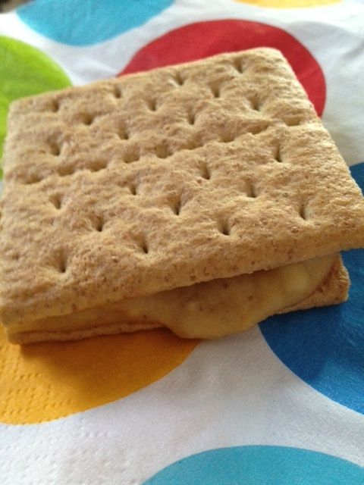


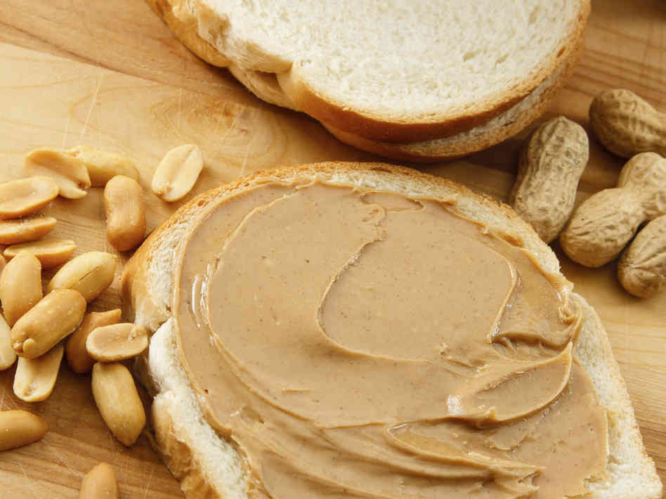

Serving size for 1500 calorie/day plan
Calories in this snack: 91
Preparation Key: *kids-can-help **parents
Nutty Banana Graham Cracker
INGREDIENTS
1 Graham cracker square
1/3 medium Banana
1/3 Tbl Natural Creamy Peanut Butter
PREPARATION
*Break graham cracker in half. Set aside.
*Mash banana with a fork in a bowl.
*Mix the peanut butter with banana.
*Spread over the graham cracker, place the other half of graham cracker on top of the other, and enjoy!
Peanut butter can be a great source of protein and a healthy boost of energy. Choose natural peanut butter as it is healthier for you. Be sure not to eat it every day because it still contains fats. If you want to mix it up, you can substitute peanut butter for almond butter, sunflower butter, or hazelnut butter
Copyright ©2015 Fit4Kidz.us |All Rights Reserved | www.fit4kidz.us

