Slide 1
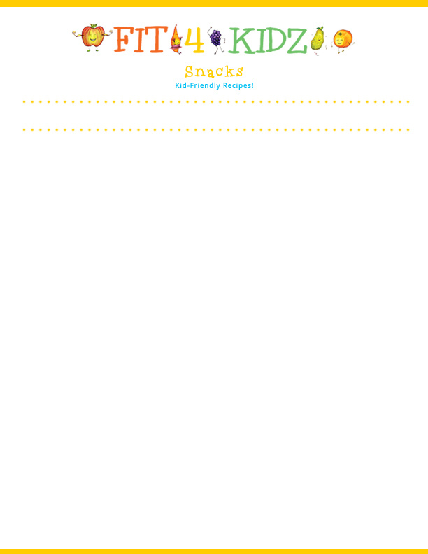
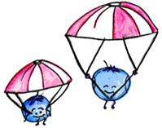
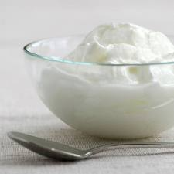
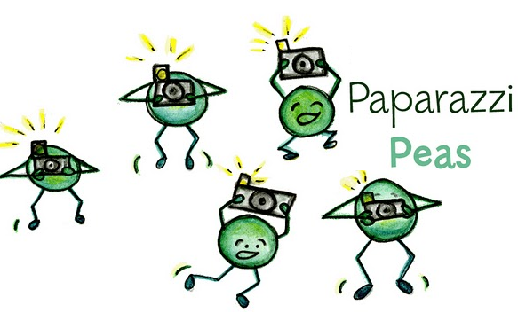


Serving Size for 1500 Calorie/Day Plan
Calories in this Meal: 97
Preparation Key: *Kids **Parents
Yogurt & Snap Peas
INGREDIENTS
Non-fat Yogurt with fruit, sugar-free 4oz. – 1 container
Snap Peas- ¾ cup
Mixed with 1 Tbl of Low-fat Italian dressing
PREPARATION
* Place snap peas into a bowl and mix with the dressing
* Serve alongside favorite fruit yogurt
Enjoy!
Did you know that…
…Yogurt is not only a serving of dairy, but it also counts toward your protein intake. Yogurt has healthy bacteria in it that keeps your tummy in tip top shape.
Copyright ©2015 Fit4Kidz.us |All Rights Reserved | www.fit4kidz.us

